Slide 1
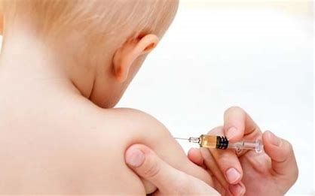
Daily Review
Antibiotics release chemicals that destroy bacteria by breaking down their cell walls. They do not harm human cells, because our cells do not have cell walls, only cell membranes.
Vaccines prompt the immune system to act as if a pathogen is present within the body.
What pathogens are used to create vaccines?

Slide 2
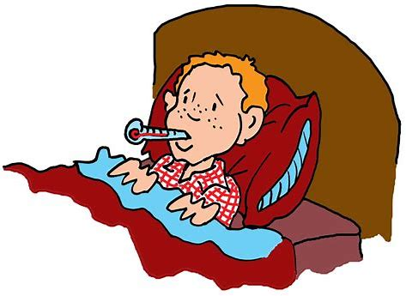
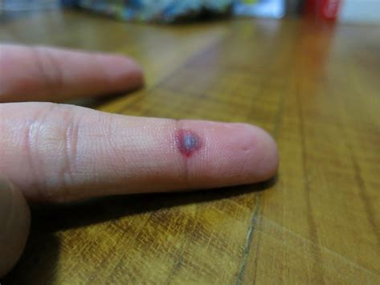
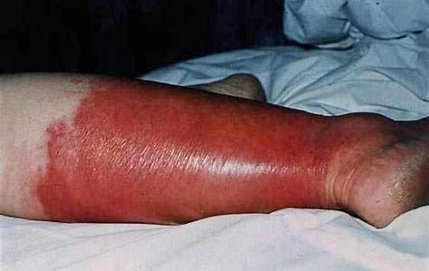
Daily Review
The immune system has a seek and destroy reaction when pathogens enter the body. It is called a non-specific immune response. Explain why.
What are the three main actions of the non-specific immune response?

Slide 3
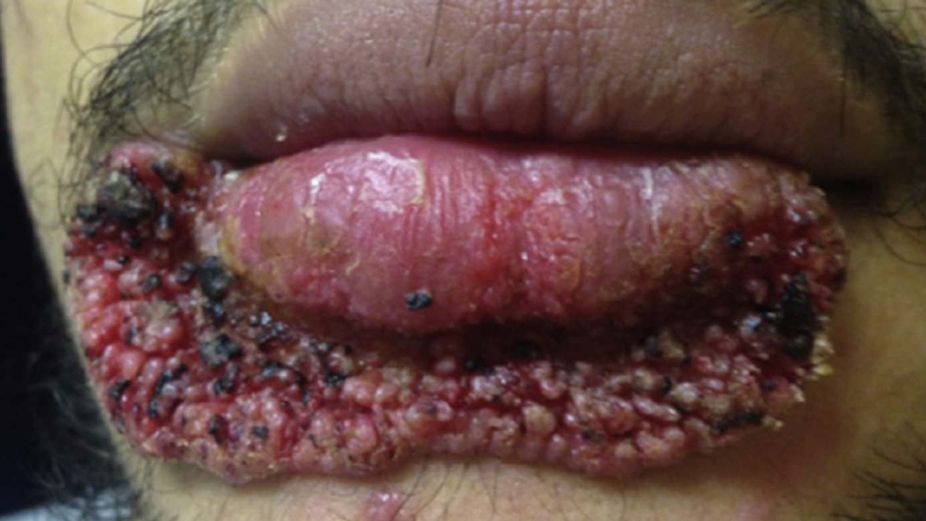
Daily Review
Reminder
Can this disease be treated with antibiotics? Why/why not?
CFU 2
Can this disease be prevented with a vaccine? Why/why not?
This infection is caused by the fungus blastomyces conidia. Its symptoms include painful blisters on the skin.
How could this disease be treated?

Slide 4
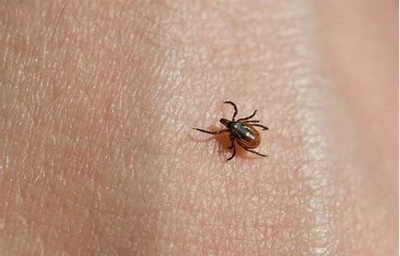
Daily Review
The first line of defence of the immune system is to prevent pathogens from entering the body.
It acts as both a physical and chemical barrier.
Explain how the skin is a:
- physical barrier
- chemical barrier

Slide 5
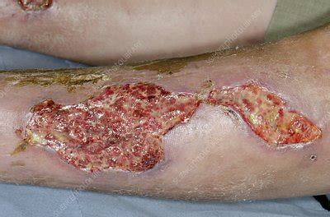
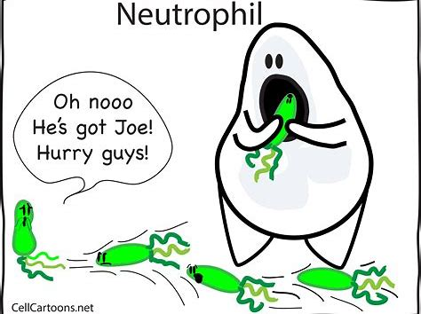
Daily Review
White blood cells seek out and destroy pathogens.
Explain what evidence there is in this picture to prove that white blood cells are in action.

Slide 6
The Immune System
Year 9 Biology

Slide 7
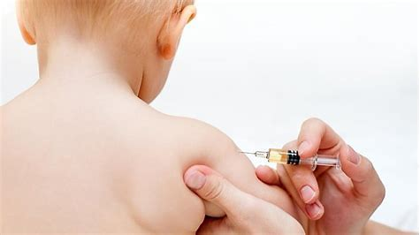
Learning Objectives
CFU
What are we going to learn?
Describe third way the immune system responds to pathogens in the body.
Activate Prior Knowledge
Humans can change their behaviour to prevent contagious diseases from being contracted.
Think, Pair, Share:
What are some diseases for which you have had a vaccination?

Slide 8
Concept Development
CFU 1
What does the immune system do?
Immune System
The role of the immune system is to prevent pathogens from entering the body, and attacking them if they do enter.
The immune system has three lines of defence against pathogens:
1. Stop pathogens entering the body
2. Seek and destroy the pathogen if it enters the body
3. Develop immunity to a pathogen
CFU 2
What does the third line of defence involve?

Slide 9
Concept Development
CFU 1
How is the third line of defence specific?
Third Defence
If pathogens survive through the body’s first two lines of defence, they are now targeted according to their type.
This is a specific immune response, and has two forms of attack using lymphocytes (white blood cells) called B cells and T cells.
The defence has long-lasting effects, as the body is able to recognise the pathogen if it comes into contact with it again in the future, and is able to destroy it much faster.
Viruses can make it to the third line of defence, as they are coated in special proteins that protect them.
CFU 2
How do viruses pass through the first two lines of defence?
CFU 3
True or False: White blood cells are also called erythrocytes.

Slide 10
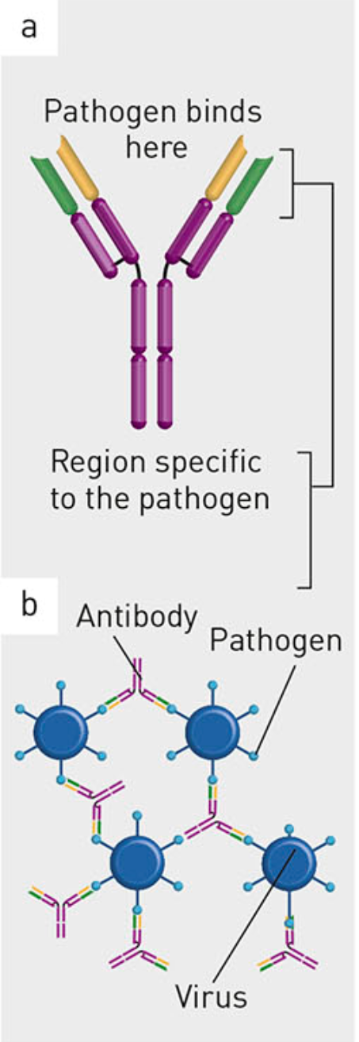
Concept Development
CFU 1
In your own words: what is an antibody?
B Cells
B cells are specialised white blood cells that produce antibodies.
B cells are produced in bone marrow.
Antibodies are specific to particular pathogens, and latch onto them as they fit their shape (like a lock and key).
Each antibody fits onto a pathogen, and collects them together so they do not function properly.

Slide 11
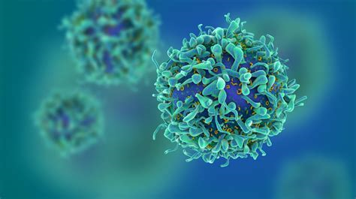
Concept Development
CFU 1
What is the role of a T cell?
T Cells
T cells are another type of white blood cell that seeks out the antibody-pathogen complex, and destroy the pathogen. The antibody is unharmed.
T cells are produced in the thymus gland.
It may take up to a week for B and T cells to recognise and destroy pathogens, which is why recovering from a disease can take time.
CFU 2
Why does it take time to recover from a disease?

Slide 12
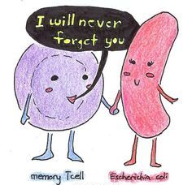
Concept Development
CFU 1
What is the purpose of a memory cell?
Immunity
As a result of B and T cells destroying a pathogen in the body, memory cells are produced.
Memory cells are kept alive in the body in case the pathogen enters again in the future.
The body knows how to destroy the particular pathogen now, and does so prior to the pathogen causing a disease.
The body is protected from reinfection.
CFU 2
What happens if a pathogen enters the body a second time?

Slide 13
Concept Development
CFU 1
How do babies receive antibodies from their mother?
Acquired Immunity
Acquired immunity arises when antibodies are created without the body experiencing the pathogen.
Babies are given acquired immunity against a few pathogens by receiving antibodies from their mother.
The antibodies can cross through the placenta, and also travel via their mother’s breast milk.
Vaccinations also provide immunity against diseases, as the body creates memory cells for the specific pathogen of the vaccine.
CFU 2
The body’s third line of defence is called natural immunity. Why do you think this is?

Slide 14
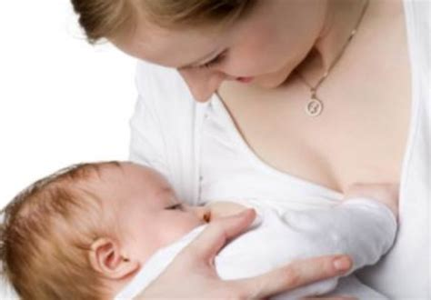
Skill Development/Guided Practice
CFU
How does the individual gain the antibodies?
A baby drinks its mother’s breast milk and receives antibodies from her.
Is this natural or acquired immunity? Explain your choice.
This is acquired immunity, because the antibodies have been given to the baby, the baby did not produce them itself.

Slide 15
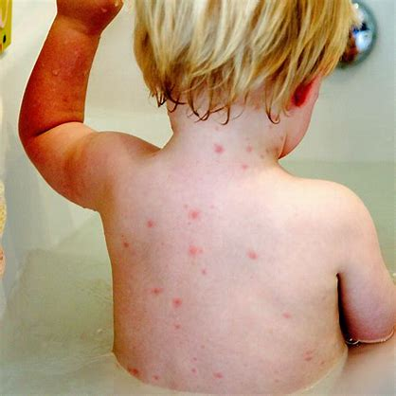
Skill Development/Guided Practice
CFU
How does the individual gain the antibodies?
A toddler contracts chicken pox and is sick for two weeks. After this, he is immune to the pathogen and will not have chicken pox again.
Is this natural or acquired immunity? Explain your choice.
This is natural immunity, as the toddler’s immune system produced the antibodies itself, it was not given to the toddler.

Slide 16
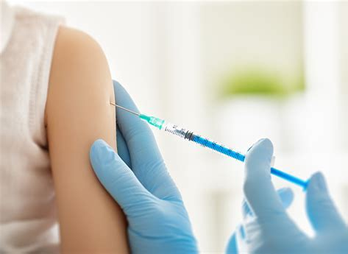
Skill Development/Guided Practice
CFU
How does the individual gain the antibodies?
Daisy visits her doctor and receives the vaccine for measles. She is now immune to this disease.
Is this natural or acquired immunity? Explain your choice.
This is acquired immunity, because the antibodies have been made by the immune system, without actually experiencing the pathogen and disease.

Slide 17
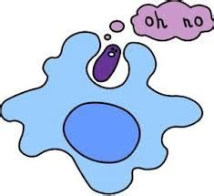
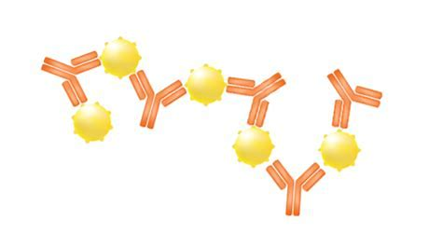
Skill Development/Guided Practice
Reminder
B cells bind to the pathogen. T cells destroy the pathogen.
Draw a diagram representing the actions of B and T cells in the immune system.

Slide 18
Relevance
Our bodies are complex organisms that are constantly responding to changes in the external and internal environment.
Knowing about the immune system and defences of the body helps you understand how our body maintains its optimal internal environment and stops pathogens damaging our bodies.

Slide 19
Skill Closure
What is the body’s third major line of defence against pathogens? How is it specific?
Skill Closure
What is the role of B and T cells?
Skill Closure
What is the difference between natural and acquired immunity?

Slide 20
Independent Practice
Complete the definitions matching worksheet, on paper or your device.
Marigold
Rafflesia
Cactus
Jasmine
Bottlebrush

